Slide 1

BI report on Online Web Store
Shreyas Khandale
RoHAN PATIL

Slide 2
What is our aim?
* To create a sales dashboard in Power BI indicating all expenses, profits and quantity of items sold to make recommendations for the online store to maximise outcome.

Slide 3
* To create quarterly representation of:
1. Sum of amount by sub-category(bookcase, printers, saree, etc)
2.Sum of quantity and sum of amount by Payment mode(UPI, Debit card, etc)
3. Sum of Profit by sub-category
4.Sum of Quantity and sum of Profit by category (Clothing, Stationary, etc)
5. Sum of Profit by Customer name
6. Sum of quantity by month

Slide 4
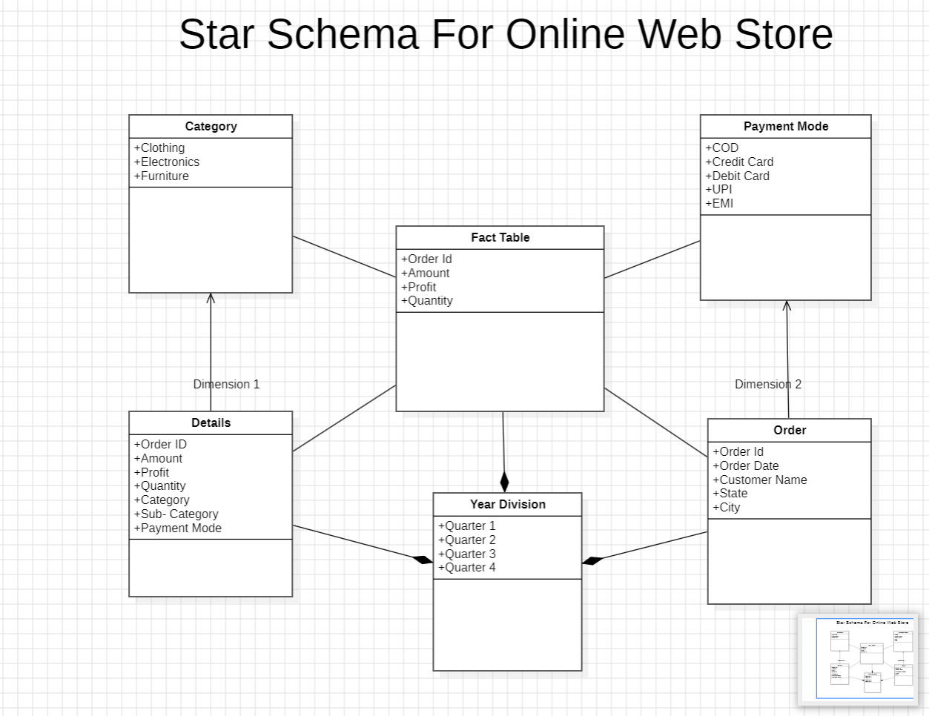

Slide 5
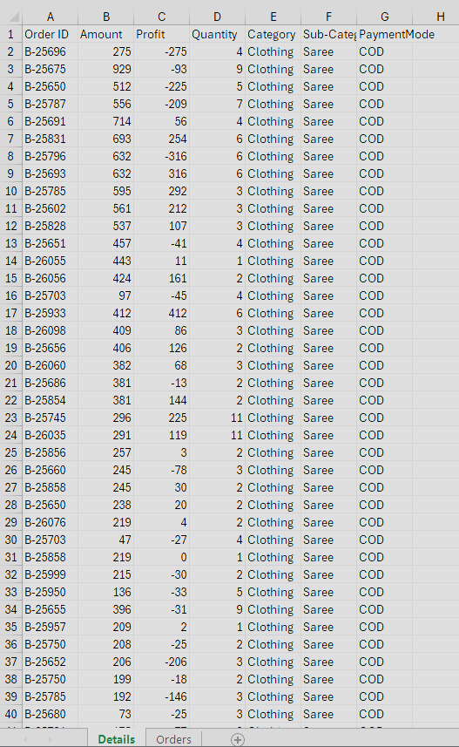
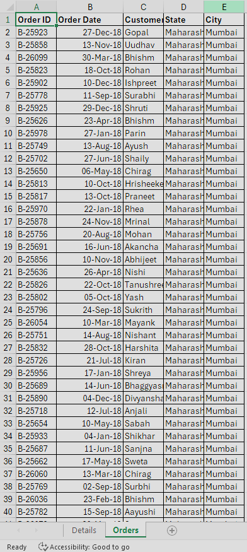
Data mining datasets
Details
Orders

Slide 6
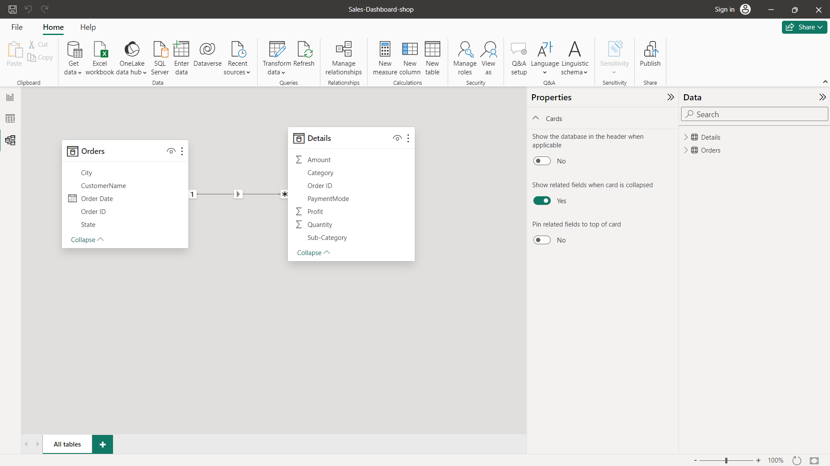

Slide 7
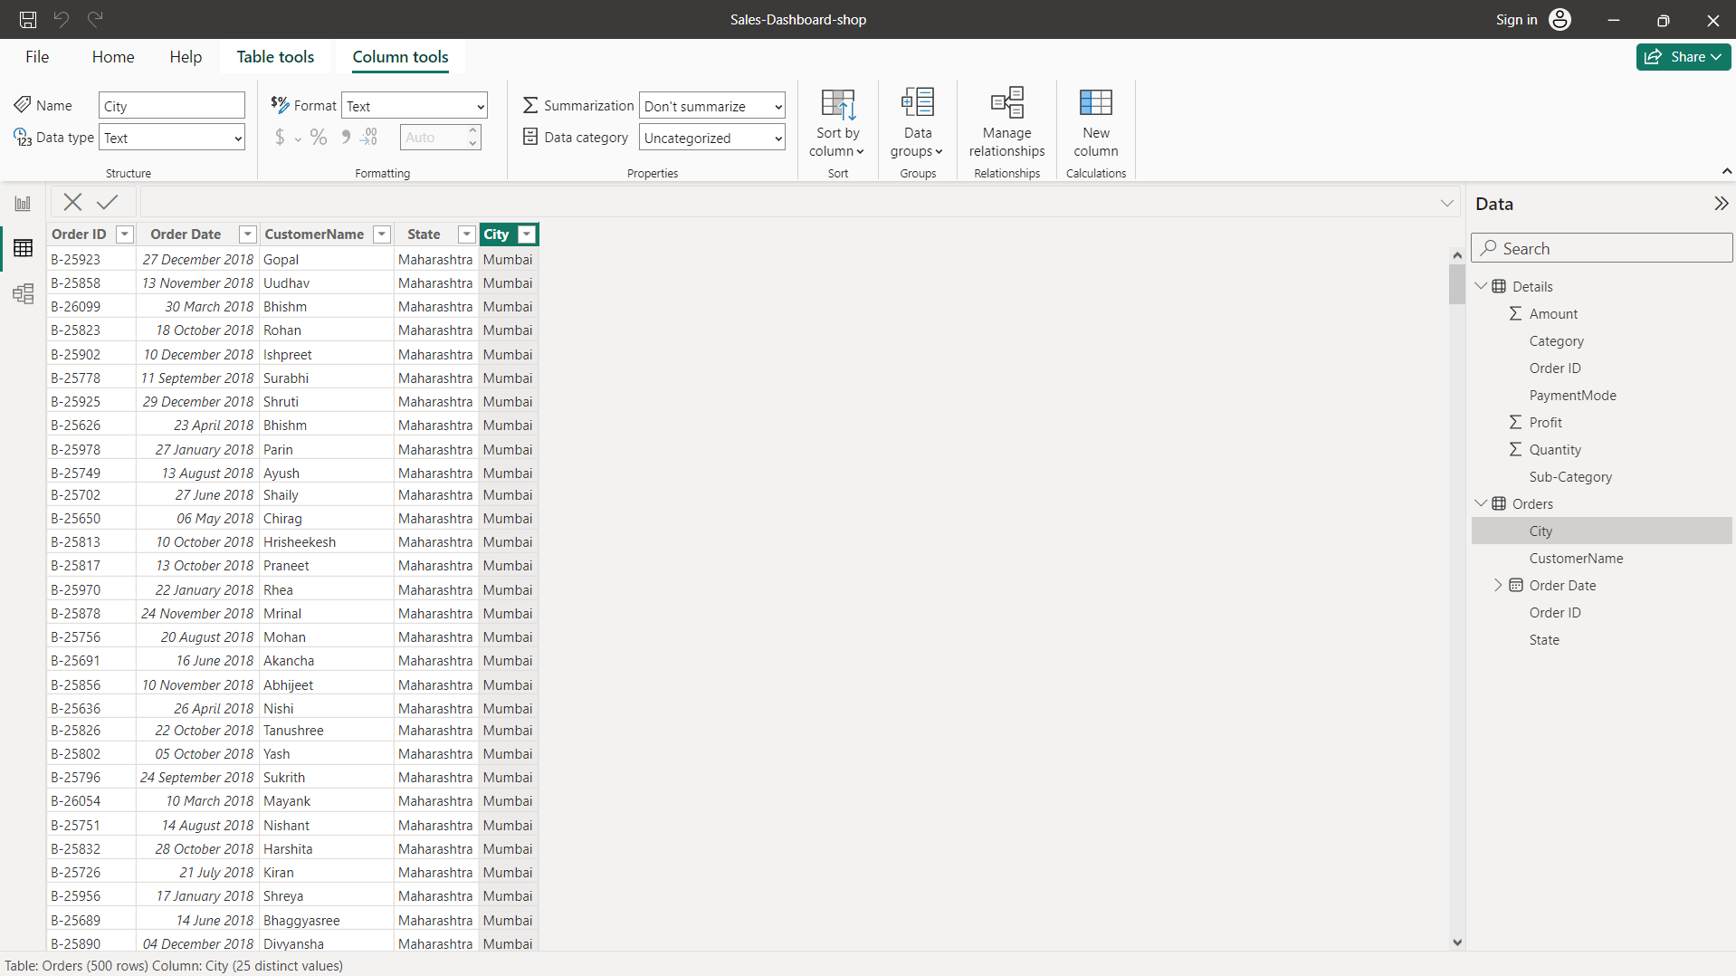

Slide 8
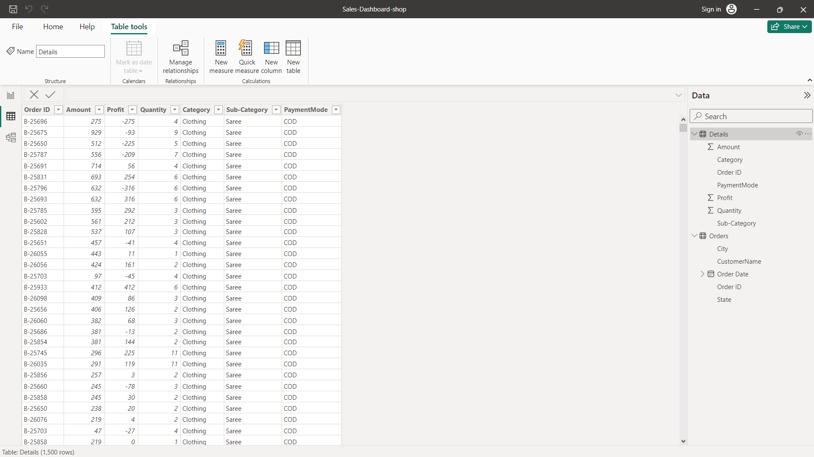

Slide 9
Thank you

